Slide 1
Analyzing Health Equity Using Household Survey Data
Lecture 12
Explaining Differences between Groups: Oaxaca Decomposition
Notes:
1.

Slide 2
What’s it all about?
Having measured inequalities, natural next step is to seek to account for them
In this and the next lecture we examine methods of decomposing inequality into its contributing factors
Core idea is to explain the outcome variable by a set of factors that vary systematically with SES
E.g. poor have lower income but also less knowledge, worse drinking water, lack insurance coverage, etc.
Want to know extent to which inequalities in health status are due to (a) inequalities in income, (b) inequalities in knowledge, (c) inequalities in access to drinking water, etc.
Notes:
After inequalities in the health sector are measured, a natural next step is to seek to explain them. Why do inequalities in health exist between the poor and better-off in many countries despite health systems explicitly aimed at eliminating inequalities in access to health care? Why is inequality in the incidence of health sector subsidies greater in one country than in another? Why has the distribution of health or health care changed over time?
In this lecture and the next, we consider methods of decomposing inequality in health or health care into contributing factors. The core idea is to explain the distribution of the outcome variable in question by a set of factors that vary systematically with socioeconomic status. For example, variations in health may be explained by variations in education, income, insurance coverage, distance to health facilities, and quality of care at local facilities. Even if policy makers have managed to eliminate inequalities in some of these dimensions, inequalities between the poor and better-off may remain in others. The decomposition methods reveal how far inequalities in health can be explained by inequalities in, say, insurance coverage rather than inequalities in, say, distance to health facilities.

Slide 3
Interpretation of decomposition results
Decomposition methods are based on regression analyses
If regressions are purely descriptive, they reveal the associations that characterise the health inequality
  Then inequality is explained in a statistical sense but implications for policies to reduce inequality are limited
If data allow identification of causal effects, then the factors that generate the inequality are identified
  Then can draw conclusions about how policies would impact on inequality
Notes:
The decompositions in this lecture and the next are based on regression analysis of the relationships between the health variable of interest and its correlates. Such analyses are usually purely descriptive, revealing the associations that characterize the health inequality, but if data are sufficient to allow the estimation of causal effects, then it is possible to identify the factors that generate inequality in the variable of interest.
In cases in which causal effects have not been obtained, the decomposition provides an explanation in the statistical sense, and the results will not necessarily be a good guide to policy making. For example, the results will not help us predict how inequalities in Y would change if policy makers were to reduce inequalities in X, or reduce the effect of X and Y (e.g., by expanding facilities serving remote populations if X were distance to provider). By contrast, if causal effects have been obtained, the decomposition results ought to shed light on such issues.

Slide 4
Oaxaca(-Blinder) decomposition
Oaxaca decomposes gap in mean of outcome vbl between two groups
Attraction of Oaxaca over decomposition in next lecture is that it allows for the possibility that inequalities caused in part by differences in effects of determinants
For example, health of the poor may be less responsive to changes in insurance coverage, or to changes in access to drinking water, etc.
Notes:
The decomposition method outlined in this lecture, known as the Oaxaca decomposition (Oaxaca 1973), explains the gap in the means of an outcome variable between two groups (e.g., between the poor and the nonpoor). The gap is decomposed into that part that is due to group differences in the magnitudes of the determinants of the outcome in question, on the one hand, and group differences in the effects of these determinants, on the other. For example, poor children may be less healthy not only because they have less access to piped water but also because their parents are less knowledgeable about how to obtain the maximum health benefits from piped water (Jalan and Ravallion 2003; Wagstaff and Nguyen 2003). The decomposition technique considered in the next chapter does not permit such a distinction between the contributions of differences in the magnitudes and the effects of determinants. In its favor, however, it does allow us to decompose inequalities in health or health care across the full distribution of say, income, rather than simply between the poor and the better-off.
Oaxaca (1973) and Blinder (1973) introduced the method independently around the same time. We refer to Oaxaca decomposition simply for brevity.

Slide 5
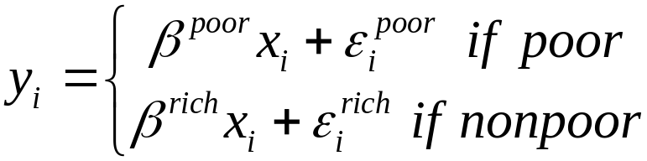
y
equation for non-poor
y^{non-poor}
equation for poor
y^{poor}
x^{poor}
x^{non-poor}
x
Notes:
Suppose we have a variable, y, which is our outcome variable of interest. We have two groups, which we shall call the poor and the nonpoor. We assume y is explained by a vector of determinants, x, according to the regression model above.
The nonpoor are assumed to have a more advantageous regression line than the poor. At each value of x, the outcome, y, is better. In addition, the nonpoor are assumed to have a higher mean of x. The result is that the poor have a lower mean value of y than do the nonpoor.

Slide 6
Gap between mean outcomes:
y
equation for non-poor
y^{non-poor}
equation for poor
y^{poor}
x^{poor}
x^{non-poor}
x

Slide 7
But how far due to diffs in β’s rather than diffs in x’s?
y
equation for non-poor
y^{non-poor}
equation for poor
y^{poor}
x^{poor}
x^{non-poor}
x
Notes:
1. We might want ask how much of the overall gap or the gap specific to any one of the x’s (in the diagram there is only one x, of course) is attributable to (i) differences in the x’s (sometimes called the explained component) rather than (ii) differences in the b’s (sometimes called the unexplained component). The Oaxaca and related decompositions seek to do just that.

Slide 8
Oaxaxa decomposition #1
y
equation for non-poor
y^{non-poor}
Δβx^{non-poor}
equation for poor
Δxβ ^{poor}
y^{poor}
x^{poor}
x^{non-poor}
x
Notes:
Triangles denote differences between groups.
Note that the difference in the b’s includes not only the difference in slopes but also in constants.
But this is only one way of writing the difference. An equally valid method is that given on the next slide.

Slide 9
Oaxaca decomposition #2
y
equation for non-poor
y^{non-poor}
Δxβ^{non-poor}
Δβx^{non-poor}
equation for poor
Δβx^{poor}
Δxβ ^{poor}
y^{poor}
x^{poor}
x^{non-poor}
x
Notes:
1. As the figures make clear, these decompositions are equally valid. In the first, the differences in the x’s are weighted by the coefficients of the poor group and the differences in the coefficients are weighted by the x’s of the nonpoor group, whereas in the second, the differences in the x’s are weighted by the coefficients of the nonpoor group and the differences in the coefficients are weighted by the x’s of the poor group. Either way, we have a way of partitioning the gap in outcomes between the poor and nonpoor into a part attributable to the fact that the poor have worse x’s than the nonpoor, and a part attributable to the fact that ex hypothesi they have worse b’s than the nonpoor.

Slide 10
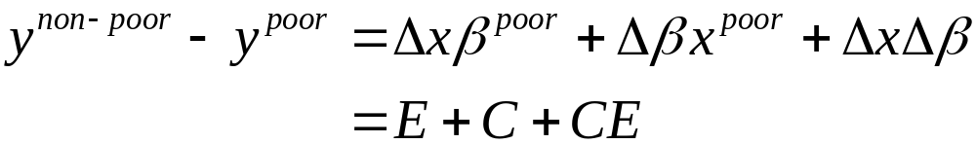
A general decomposition
E – gap in ‘endowments’ (“explained”)
C – gap in ‘coefficients’ (“unexplained”)
CE – interaction of differences in endowments &
coefficients
Oaxaca decomposition #1:
Oaxaca decomposition #2:
Notes:
The interaction effect is difficult to interpret.
The first decomposition places the interaction in the unexplained part and the second places it in the explained part.

Slide 11

Other decompositions
I is the identity matrix, D is a matrix of weights
D=0 → Oaxaca decomposition #1
D=1 → Oaxaca decomposition #2
diag(D)=0.5 → diffs. in x’s weighted by mean of coeff. vectors
(Cotton, 1988)
diag(D)=N_{np}/N → diffs. In x’s weighted by sample fraction non-poor (Reimers, 1983)
And a further decomposition (Neumark, 1988):
where is the coefficient vector estimated from pooling the two groups
Notes:
1. diag(D) refers to the diagonal of the weighting matrix D.

Slide 12
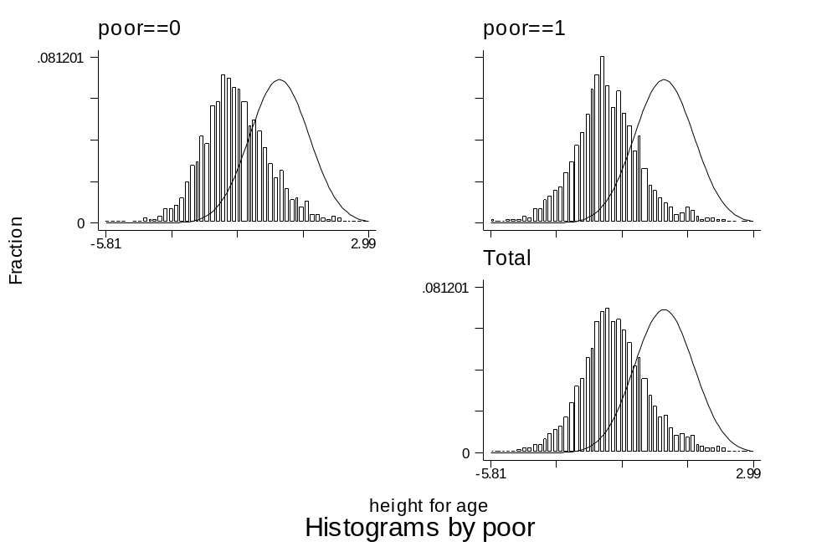
Decomposition of poor–nonpoor differences in child malnutrition in Vietnam
Mean HAZ z-score kids<10 yrs:
Poor = -1.86
Non-poor = -1.44
Diff = 0.42
U.S. reference group = 0.00
Height-for-age z-scores
Notes:
We illustrate the decompositions by means of an example. The setting is Vietnam. The aim of the exercise is to explain the difference between the poor and the nonpoor in child malnutrition, measured anthropometrically through height-for-age z-scores (see lecture 4).
We classify (under-10) children as poor if they are below the poverty line of D 1,790,000 (D = Vietnamese dong), which is the classification developed by the World Bank (Glewwe, Gragnolati, and Zaman 2000) and used by the government of Vietnam. On this basis, using sample weights, we have 46 percent of under-10 children being classified as poor. The figure shows that poor children (poor = 1) tend to have a height-for-age z-score (HAZ) lower than that of nonpoor children (poor = 0). The mean HAZ values among the nonpoor and poor are –1.44 and –1.86, respectively. A mean of 0.00 would place the group in question at the 50th centile in the U.S. reference sample of well-nourished children (distribution sketched in figures), so even the average nonpoor child in Vietnam is substantially undernourished by U.S. standards. Our focus here is on explaining the gap of 0.42 between the mean HAZ of nonpoor and poor children.

Slide 13
The regression equation
y is the HAZ malnutrition score
Same regression model as Wagstaff et al.(2003)
x includes
  log of the child’s age in months (lnage)
  sex = 1 if male
  safewtr = 1 if drinking water is safe
  oksan = 1 if satisfactory sanitation,
  years of schooling of the child’s mother (schmom)
  log of HH per capita consumption (lnpcexp)
  poor = 1 if child’s HH is poor (if pcexp<Dong 1,790,000 )
Notes:
1. See lecture 10 for the specification of the regression model and some results.

Slide 14
Differences in means between non-poor and poor
Variables | Non-poor | Poor
Lnage | 4.021 | 3.952
Sex | 0.513 | 0.491
Safwtr | 0.421 | 0.221
Oksan | 0.313 | 0.069
schmom | 7.696 | 5.739
lnpcexp | 7.99 | 7.162
Notes:
1. We see that the poor have lower consumption, as must be, but also that they have lower access to satisfactory sanitation and drinking water on average. And their mothers have less years of schooling. All of these differences could contribute to the difference in malnutrition.

Slide 15
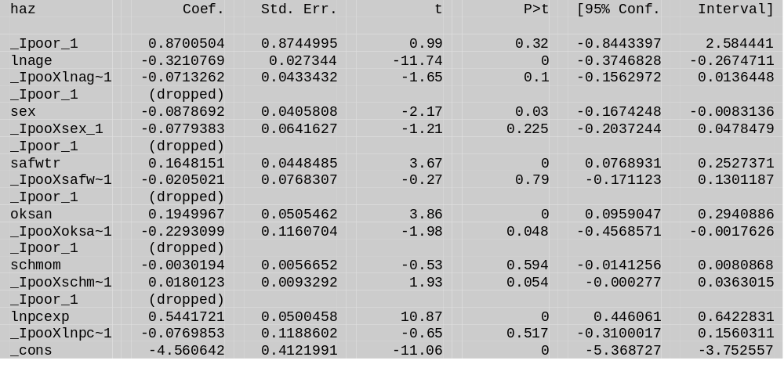
Are there signficant differences in the coefficients?
xi: reg haz i.poor*lnage i.poor*sex i.poor*safwtr i.poor*oksan i.poor*schmom i.poor*lnpcexp [aw=wt]
testparm poor _I*
On an individual basis, differences in effects are only signif. (10%)
For sanitation and mother’s education
F( 7, 5154) = 2.03
Prob > F = 0.0472
Notes:
The first command runs a regression with the poor dummy included alone and interacted with all the x’s. The second command tests the hypothesis that the coefficients on the poor dummy and its interactions are simultaneously equal to zero. The F-statistic, with 7 and 5154 degrees of freedom, is 2.03 and has a p-value of 0.0472. Thus the Oaxaca-type approach, which allows for different regression coefficients, makes some sense in this context, although rejection of the null of parameter homogeneity is somewhat marginal.
On an individual basis The lack of significant differences in the coefficients indicates that we should be careful not to read too much into the contribution of coefficient differences in the decomposition.

Slide 16
Decomposition of poor-nonpoor malnutrition gap into main effects
decompose haz lnage sex safwtr oksan schmom lnpcexp
[pw=wt], by(poor) detail estimates
Mean prediction high (H): | -1.442
Mean prediction low (L): | -1.861
Raw differential (R) {H-L}: | 0.419
- due to endowments (E): | 0.406
- due to coefficients (C): | -0.082
- due to interaction (CE): | 0.095
Notes:
Decompose is Ben Jahn’s Stata ado. It has now been superseded by Oaxaca, which has the advantage of computing standard errors for the contributions.
Here H refers to the nonpoor and L to poor.
The first 3 numbers give the actual means and the gap. Next come the estimates of the main contributions from differences in all x’s, all b’s and the interaction effect.
It is clear, as could be anticipated from previous tests, that by far the majority of the gap is explained by differences in the means of the covariates and not by differences in their effects.

Slide 17
Main decomposition results with different weighting schemes
D: | 0 | 1 | 0.5 | 0.562 | *
Unexplained (U){C+(1-D)CE}: | 0.014 | -0.082 | -0.034 | -0.038 | -0.032
Explained (V) {E+D*CE}: | 0.406 | 0.501 | 0.454 | 0.458 | 0.451
% unexplained {U/R}: | 3.2 | -19.5 | -8.1 | -9.1 | -7.5
% explained (V/R): | 96.8 | 119.5 | 108.1 | 109.1 | 107.5
Notes:
These results also come from the decompose ado.
shows how the explained and unexplained portions of the outcome gap vary depending on the decomposition used. The first and second columns correspond to the Oaxaca decomposition in equations 12.4′ and 12.5′, where D = 0 and D = I, respectively. The third and fourth columns correspond to Cotton’s and Reimers’ decompositions, where the diagonal of D equals 0.5 and fNP = 0.562 (in our case), respectively. The final column labeled “*” is Neumark’s decomposition.
Whatever decomposition is used, it is clearly the difference in the mean values of the x’s that accounts for the vast majority of the difference in malnutrition between poor and nonpoor children in Vietnam. Differences in the effects of the determinants play a tiny part in explaining malnutrition inequalities.

Slide 18
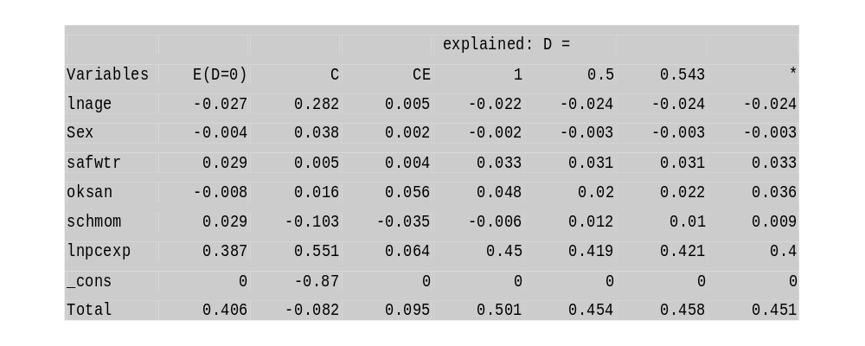
Which covariates explain most of the gap?
Notes:
The third block of output allows the user to see how far gaps in individual x’s contribute to the overall explained gap.
The first 3 columns show the explained, unexplained and interaction effect for each covariate for the first Oaxaca decomposition.
The remaining rows show the explained contributions for different weighting schemes.
Focusing on the final column corresponding to Neumark’s decomposition, we see that the gaps in the two demographic variables actually favor the poor, whereas the gaps in the remaining variables all disfavor the poor. Of the latter, it is the gap in household consumption that accounts for the bulk of the explained gap. It is not so much the correlates of poverty (poor water and sanitation, low educational levels) that account for malnutrition inequalities between poor and nonpoor children in Vietnam—it is poverty itself, in the form of lack of purchasing power.

Slide 19
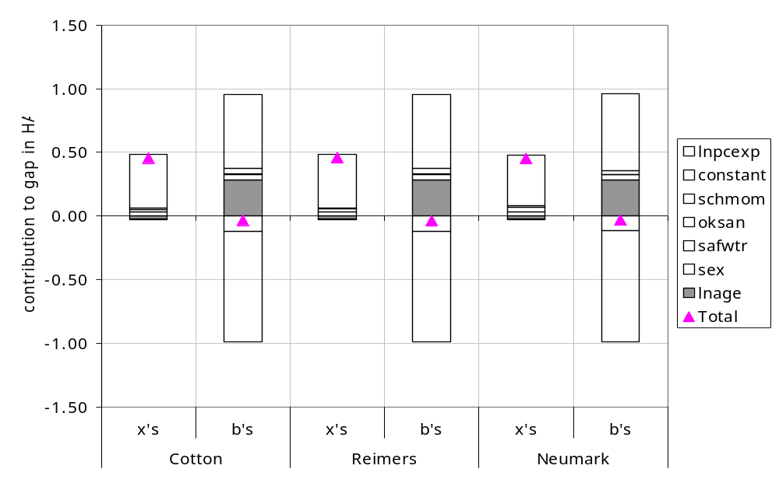
Contributions of Differences in Means and in Coefficients to Poor–Nonpoor Difference in Mean HAZ
Notes:
As far as the means of the x’s are concerned, the figure tells us simply what we already knew from the second block of output: most of the explained part of the malnutrition gap is attributable to the gap in per capita consumption.
The triangles in the chart, which indicate the overall contributions of the x’s and the b’s, also show us something else we already knew: that the bulk of the gap in malnutrition is from gaps in the x’s, not gaps in the b’s.
The figure makes clear that the unimportance overall of the unexplained portion is due to offsetting effects from different b’s. The poor have a higher intercept in the HAZ equation, but this is largely offset by the fact that the consumption effect is weaker for the poor.

Slide 20
Decomposition of differences in complete distributions
The standard Oaxaca-type decomposition explains differences in means
But differences in other parameters are of interest e.g. % kids malnourished
Machado & Mata (2005) show how to decompose differences in full distributions using quantile regression
This has the further advantage of allowing the effects of covariates to vary across the distribution e.g. income can have a larger effect at higher than lower levels of nutrition

Slide 21
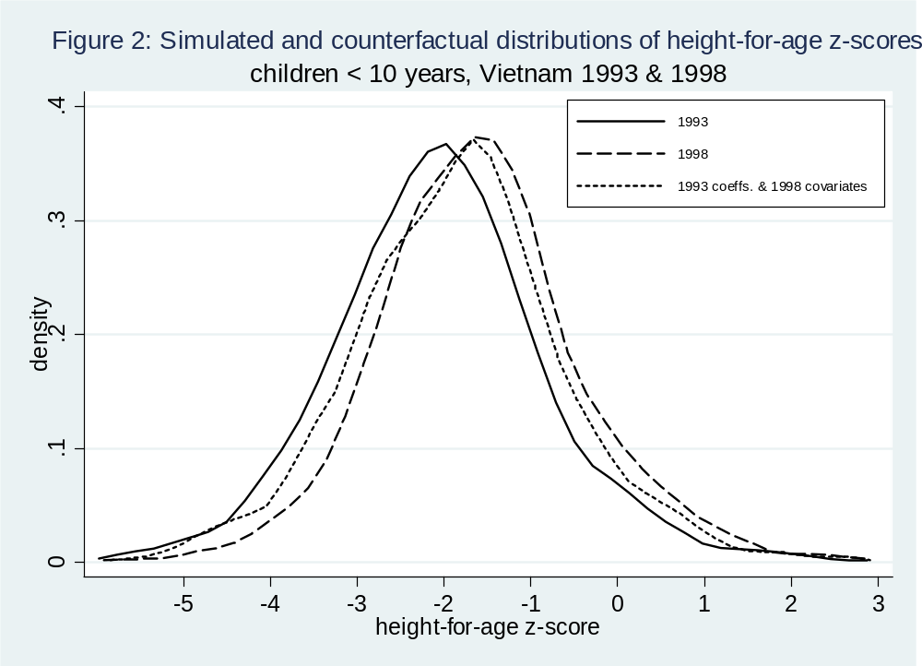
Explaining change in the full distribution of HAZ in Vietnam b/w 1993 & 1998
Notes:
This is from O’Donnell, Lopez and van Dooslaer (2008) Journal of Development Economics, forthcoming.
The solid line shows the empirical density of HAZ scores in 1993 (or rather a simulation of it).
The long-dashed line plots the empirical density in 1998.
The short-dashed line plots the density under the counterfactual that coefficients remain as they were in 1993 but the distributions of all covariates changes to 1998 values.
Comparing the 1993 density with the counterfactual gives the contributions of changes in covariates.
Comparing the 1998 density with the counterfactual gives the contributions of changes in the coefficients.
We can see that at extremely high levels of malnutrition, most of the again in nutrition over the period is explained by changes in coefficients.
At the mode of the distribution, it is changes in covariates that explain most of the change.
At other points changes in coefficients and covariates contribute approximately equally.

